Slide 1
Social Media Data Analysis
Team:
Hanu Pathuri
Mohammed Tawashi
Amir Shirkhani
Naveed Mohammed
Vamsi Namuduri
Advisors:
Prof. Amarnath Gupta

Slide 2
Project Focus:
Social media is the prime focus of this project. There are several opportunities to discover interesting facts and trends on various platforms. The opportunity that the team pursued is exploratory analysis of Twitter data with Media.

Slide 3
Why Twitter?
There are 330m monthly active users and 145 million daily users. A total of 1.3 billion accounts have been created. 500 million people visit the site each month without logging in

Slide 4
Stake Holders and Business Value
1- Election Organizers: As part of a campaign, they can study and detect endorsing and opposing trends and act by counter measures using similar techniques. 2- Twitter: Platform itself can detect patterns and potentially restrict the behavior. 3- Journalists: Report to general public on how a small group of influencers moving the narrative and pushing various agendas. 4- General public

Slide 5
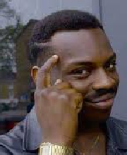
Main Hypotheses :
Can we coordinate cluster of images using the tweet’s texts?
Can we provide an input distribution ( expected distribution ) and get an interesting response?
Can we investigate the hashtag co-occurrence (pairwise) relationships and find how media files may change the narrative?

Slide 6
Data Preparation

Slide 7
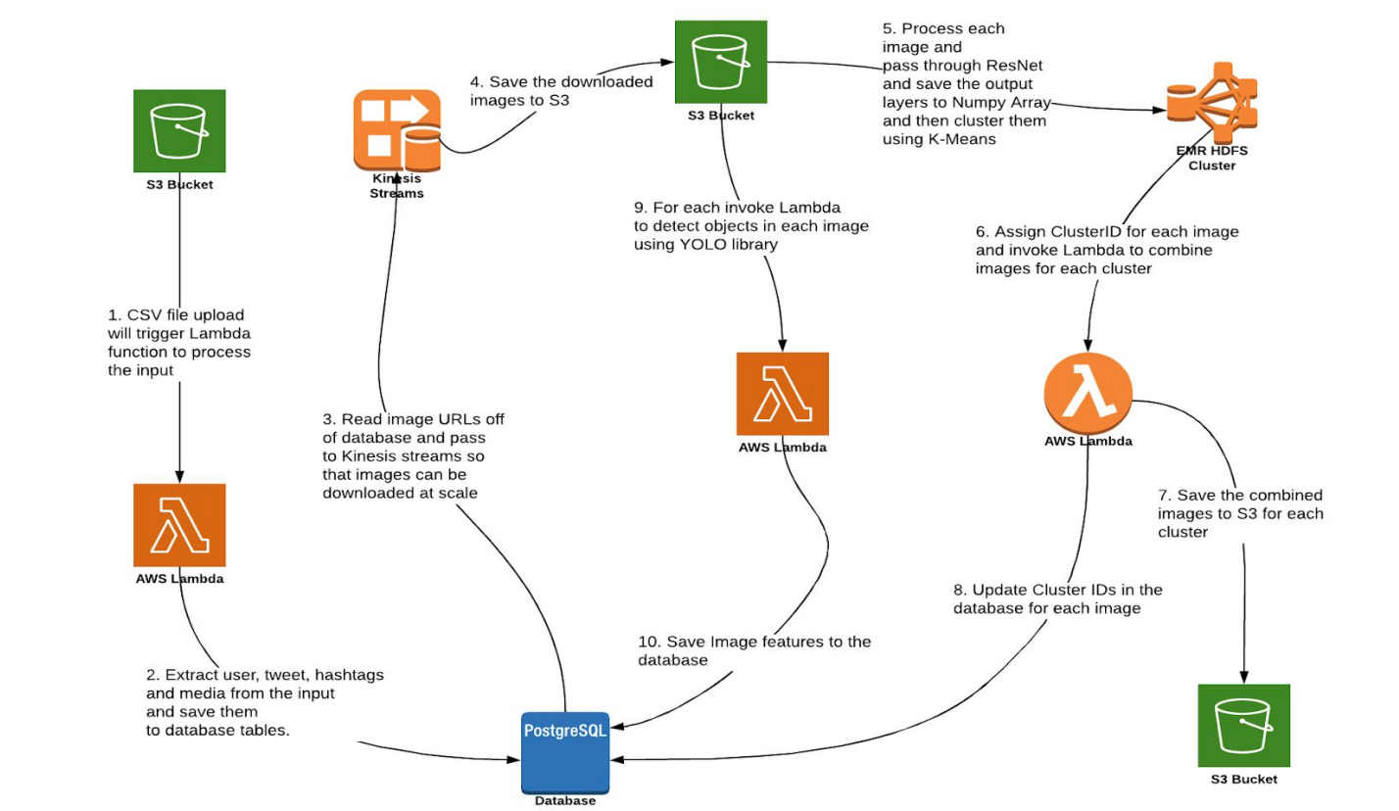
Solutions Architecture

Slide 8
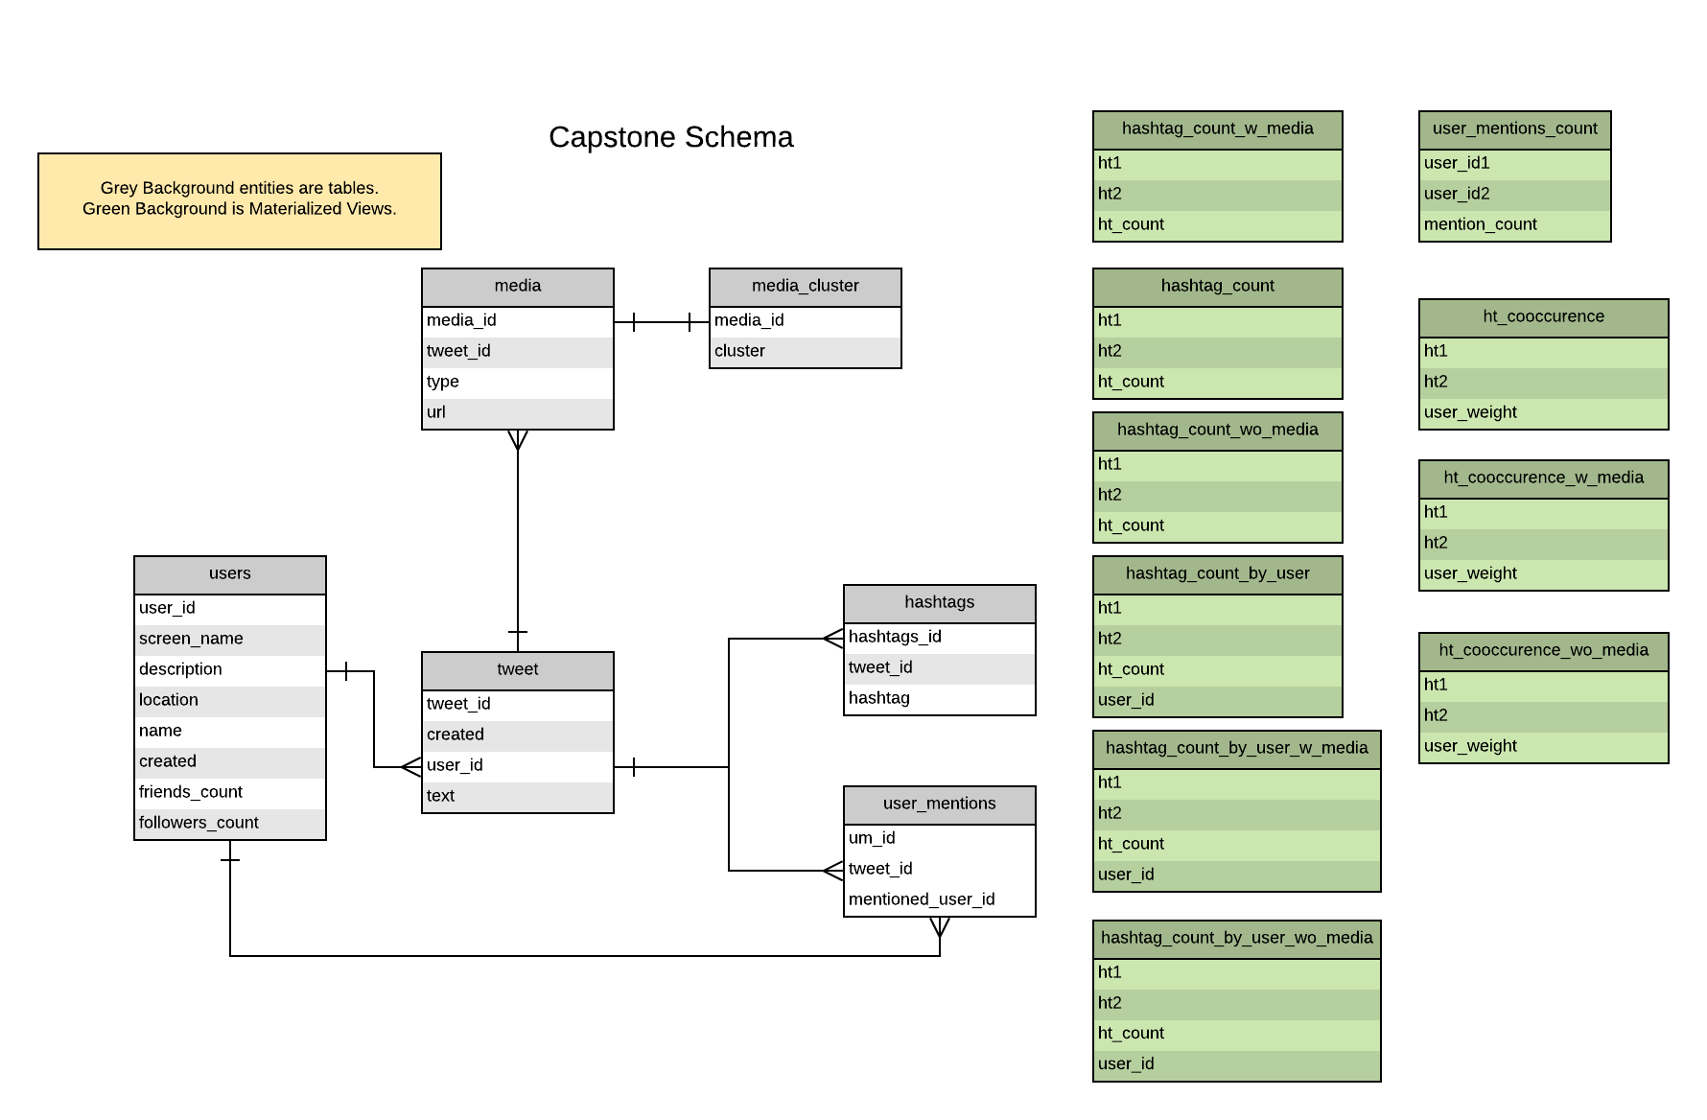
Database Schema

Slide 9
Status of Tables in DB ( Dec 2019 )
Users | 2,473,910
Tweet | 22,958,670
Media | 664,932
Hashtags | 2,308,751
User Mentions | 31,520,555

Slide 10
Data Distribution
Tweets with Media: 2.9%
Overall hashtag: 10%
Media tweets with hashtag: 3%
Average tweets /user: 9

Slide 11
Feature Engineering
Existing Features:
'created_at', 'in_reply_to_status_id', 'in_reply_to_user_id', 'source','retweet_count', 'retweeted', 'in_reply_to_screen_name','is_quote_status', 'favorite_count', 'id', 'text', 'place', 'lang','reply_count', 'userid', 'retweeted_id', 'hashtag', 'media',
'url', 'geo’,

Slide 12
Feature Engineering
New Features augmented :
YOLO object detection with OpenCV to get Objects in Images
SentimentIntensityAnalyzer: Polarity, Subjectivity, etc.
Pytesseract: Extract text from images

Slide 13
Analysis Methods

Slide 14
Analysis Method 1) Images

Slide 15
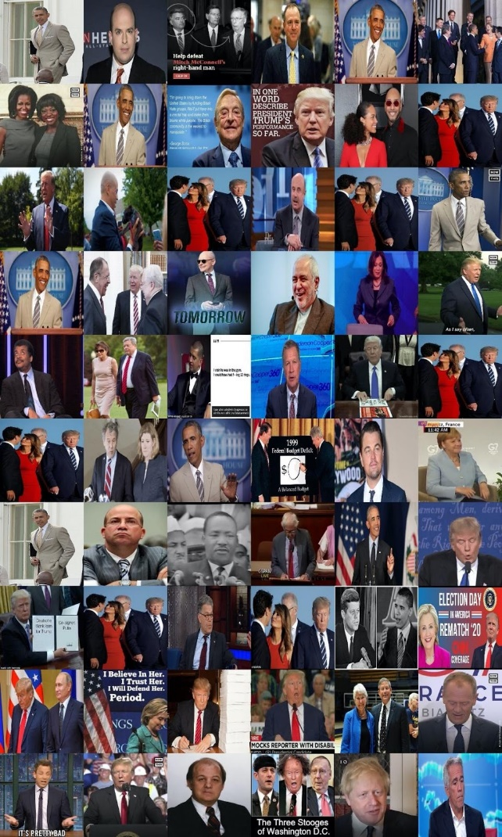
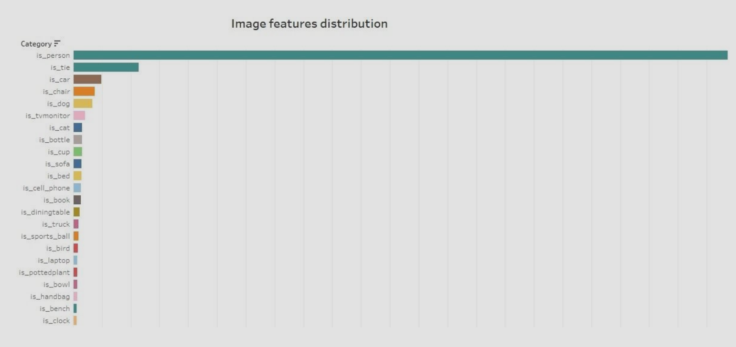
Cluster of images

Slide 16
What are the insights for Images?
Image feature extraction did not reveal any new insight
Extracted 80 different object classes in the initial 2K image dataset
Mostly found persons in 90% of images
Other objects are ‘tie’, few animals etc.

Slide 17
Analysis Method 2) Tweet Topics

Slide 18
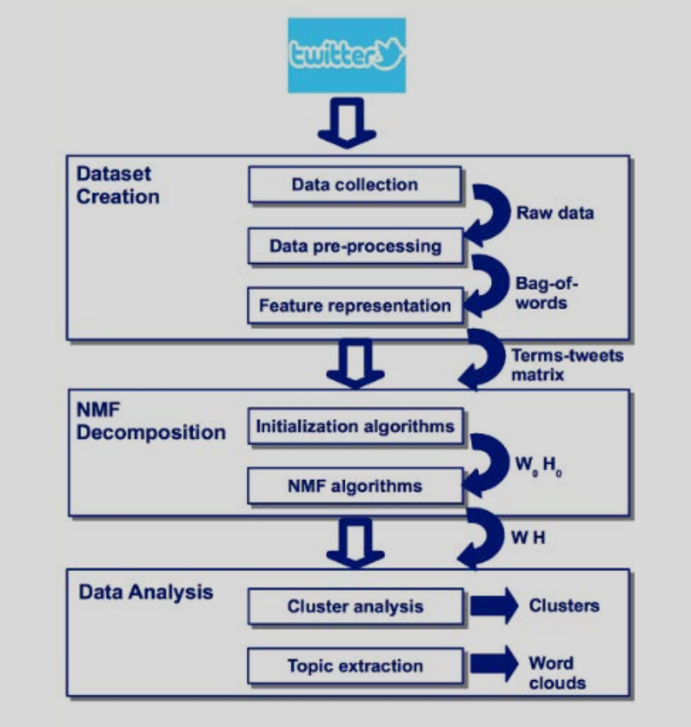
Topic Analysis Pipeline

Slide 19
Topic Modeling of Tweets:
Preprocessing: Removed URLs, RT, CC, hashtags, mentions, numbers, extra white-space)
NMF (generalized Kullback-Leibler divergence):
Topic #0: like got thats said way better little looks looking talking aint true tell ass jay dog bad family post feel
Topic #1: love ce titre men thanks fucking hate story sure miss queen shes thread forever talk watching share comes hope gotta
Topic #2: im shit twitter fuck going come trying tweet yes tonight lol retweet party wrong gonna mood stay niggas told lmao
Topic #3: new video best week ive live seen ill start favorite free season help home right gets hit friend team internet
Topic #4: happy birthday year baby th years old beautiful king st weekend august friday mother today michael died makes greatest jackson
Topic #5: time know life make stop just president youre lets girl let took didnt play says lost hes end remember american
Topic #6: trump great thank architecture fight save following wasnt followed link maga america nation patriots african country afro brets
donald south
Topic #7: good look work morning real world god oh heres night guy damn getting guys did whats check class boy killing
Topic #8: people dont black man really white say need right want vs big think isnt women hurricane bernie word jayz photo
Topic #9: day yall today watch ready thing game coming nigga popeyes entire school thought years ago theres long spot wants sound

Slide 20
Topic Modeling of Tweets:
LDA
Topic #0: good day white make thing week men morning th didnt ive ready bernie remember word house hell hot august kind
Topic #1: like people know video years think thats thank real god hes hurricane nigga oh took start home history true retweet
Topic #2: happy going birthday world lets ce titre american dog help hate king news wow hit gets change friday thread amazing
Topic #3: got work come fuck live coming getting heres jayz theyre dave nfl straight niggas link music hear kid friends story
Topic #4: dont trump president save says african end food makes beautiful lost family left favorite days yes check bu making past
Topic #5: black time new right look like shit want hair old let tell tweet fucking ass looks feel killing wrong internet
Topic #6: need youre watch stop year vs game ill seen guy gonna doesnt did believe thought things wanna rest racist pm
Topic #7: great said twitter isnt fight st kids jay maga wasnt post following tonight damn country nation photo patriots experience stan
Topic #8: im today say life women better school luxury little girl night america architecture trying free party ago support looking read
Topic #9: love yall really man best just way big lol talking baby aint girls weekend thanks hard wait bad bitch died

Slide 21
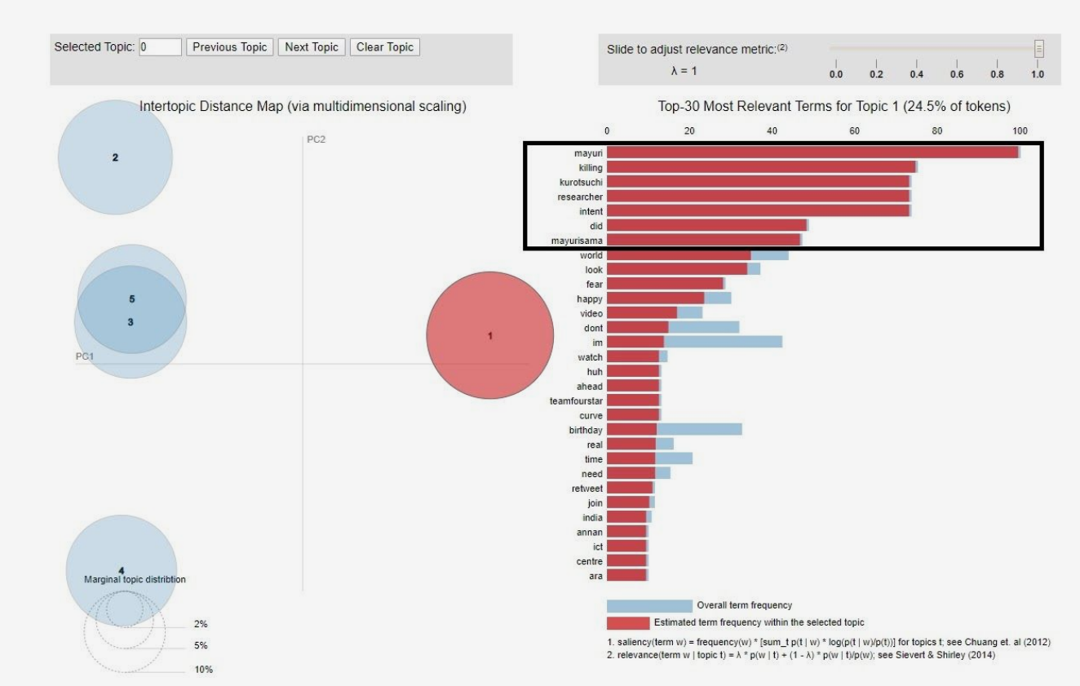
Topic Modeling of Tweets:
Example:
Japanese fictional
characters in cluster 15

Slide 22
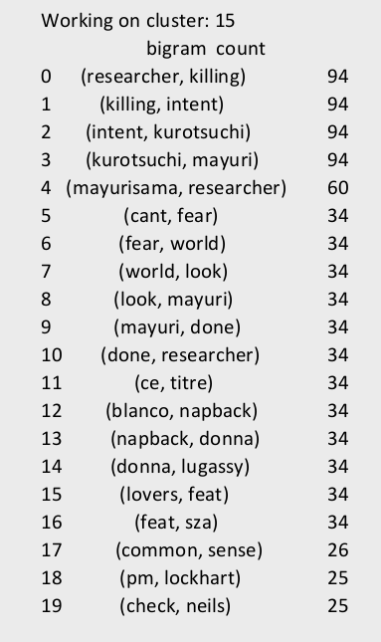
Topic Modeling of Tweets:
Bigram Analysis:

Slide 23
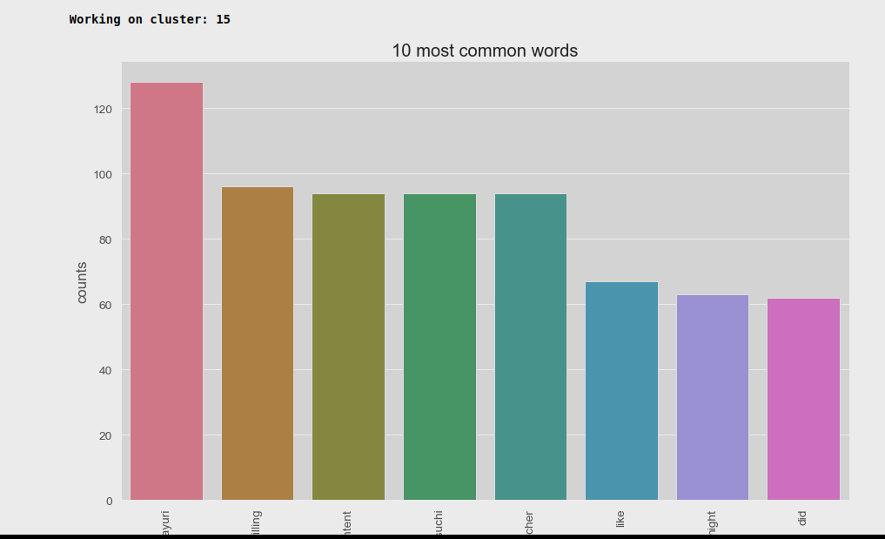
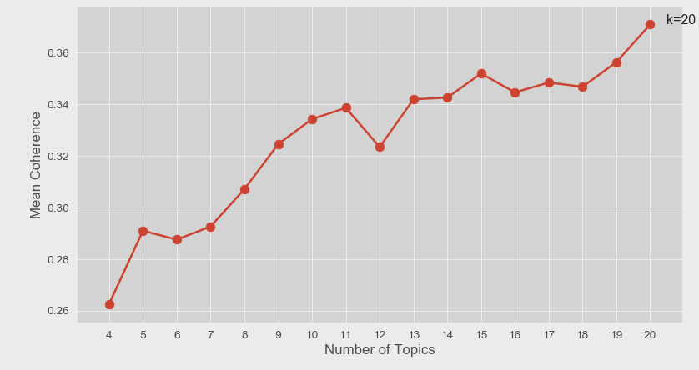
Topic Modeling of Tweets:
Optimal number of topics for cluster 15

Slide 24
Analysis Method 3) Semantic Structural Analysis of HashTags

Slide 25
Semantic Structural Analysis of HashTags
Steps taken in Semantic Analysis
Identify segmented HashTags
Identify Synonyms for each Segment
Calculate JaccardIndex for a pair of HashTags as Intersection
(Synonyms(H1),Synonyms(H2))/Union(Synonyms(H1),Synonyms(H2))
Compute the similarity as JaccordIndex if JaccardIndex <0.5 else Max
(JaccardIndex,levenshtein_similarity).

Slide 26
Semantic Structural Analysis of HashTags
Sample results in 200k tweet dataset:
star : ['star' 'starfox' 'starlink']
voteblue2020 : ['voteblue2020' 'backtheblue']
falco : ['falco' 'falcolombardi']
knowthyself : ['knowthyself' 'detroitjazzfest']
aphia : ['aphia' 'qanon']
amazon : ['amazon' 'amazonrainforest']
michaeljackson : ['michaeljackson' 'michaeljacksonday' 'happybirthdaymichaeljackson']
liberalismisamentaldisease : ['liberalismisamentaldisease' 'netflixisajoke']
ontrumpstodolist : ['ontrumpstodolist' 'dosomething']
backfiretrump : ['backfiretrump' 'trump' 'trump2020']
obamaoutdidtrump : ['obamaoutdidtrump' 'trump' 'trump2020']

Slide 27
Semantic Structural Analysis of HashTags
Sample results in 200k tweet dataset cont.
schoolstrike4climate : ['schoolstrike4climate' 'climatestrike']
starlinkgame : ['starlinkgame' 'starlink']
hurricanedorian : ['hurricanedorian' 'hurricanedorian2019']
internationaldogday : ['internationaldogday' 'nationaldogday']
blacktwitter : ['blacktwitter' 'blackaugust' 'blackcommunity']
nintendoswitch : ['nintendoswitch' 'switch']
jayz : ['jayz' 'jayznfl']
powertv : ['powertv' 'powerpremiere']
thersday : ['thersday' 'teamday']
foxmccloud : ['foxmccloud' 'fox']
fridaythoughts : ['fridaythoughts' 'saturdaythoughts' 'thursdaythoughts']
art : ['art' 'nudeart']
adospolitics : ['adospolitics' 'ados' 'dosomething']
florida : ['florida' 'dorianflorida']

Slide 28
Analysis Method 4) Hashtag pairs (co-occurrence)

Slide 29
HashTag Cooccurrence Analysis
This hypothesis analysis is partitioned into 3 phases:
Network of hashtag pairs and co-occurrence analysis.
Topic Model analysis on aggregated tweet texts per hashtag.
Topic Model analysis with media/non-media tweets distinction.

Slide 30
Hashtags Topics incoherent detector
This detector highlights any change of the hashtags topics when they co-occurred together. It also checks if media files (images, videos) are used to achieve this change of narrative. Method design: Build and train a topic model (using NMF/LDA) based on aggregated tweets text per each hashtag (not per single tweet text). The aggregated text is cleaned before modeling by removing URLs, RT and cc,hashtags, mentions, double spacing, numbers, punctuations, and converting all to lowercase. Apply topic modeling to generate a dominant topic per each single hashtag over its aggregated tweets text. Calculate each hashtag weight based on the number of unique users that tweeted that hashtag

Slide 31
Hashtags Topics incoherent detector (cont.)
Aggregate all tweets texts of any 2 co-occurred hashtags in same tweets and that these tweets have associated media files. Then apply the topic modeling on the aggregated cleaned text. Aggregate all tweets texts of any 2 co-occurred hashtags in same tweets and that these tweets don’t have associated media files. Then apply the topic modeling on the aggregated cleaned text. Calculate the hashtags co-occurrence weight based on unique users who used these 2 hashtags jointly. This is done for both cases (media and no media). Generate a new data frame for the common (interested) hashtags between the 2 cases of media and no media co-occurrences

Slide 32
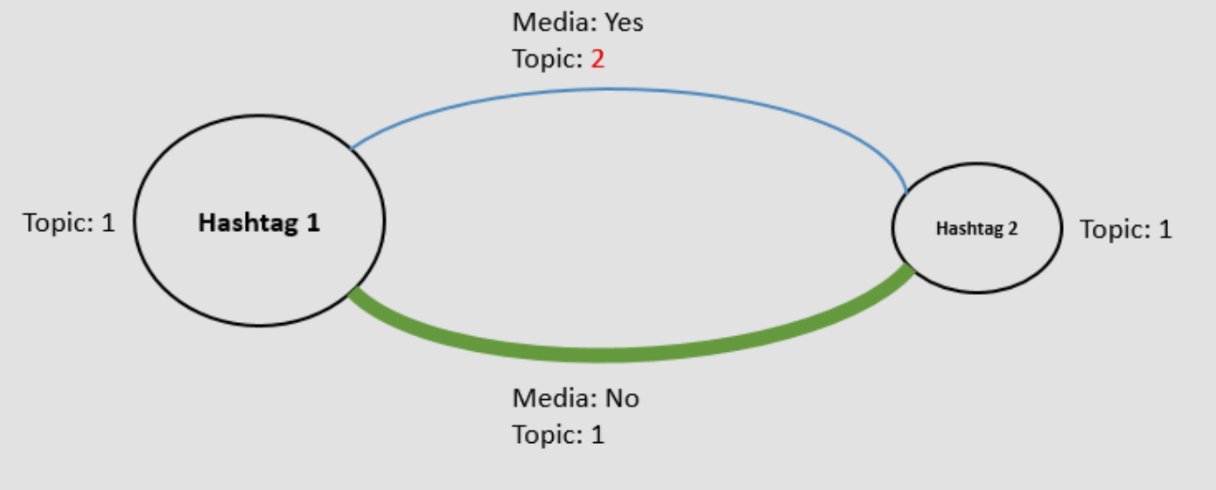
HashTag Network Analysis
Model checks if these 4 topics are incoherent, especially the edge topics (co-occurred topics), in addition it also checks if the user concentration factor (tweets/user) on these edges is high. In such cases there is an attempt to change the narrative of these hashtags.

Slide 33
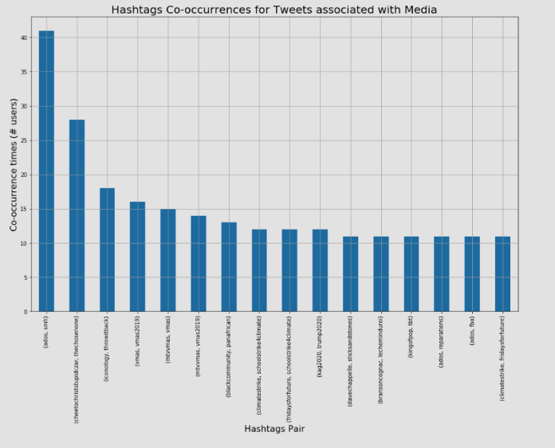
HashTag Co-occurrences with media

Slide 34
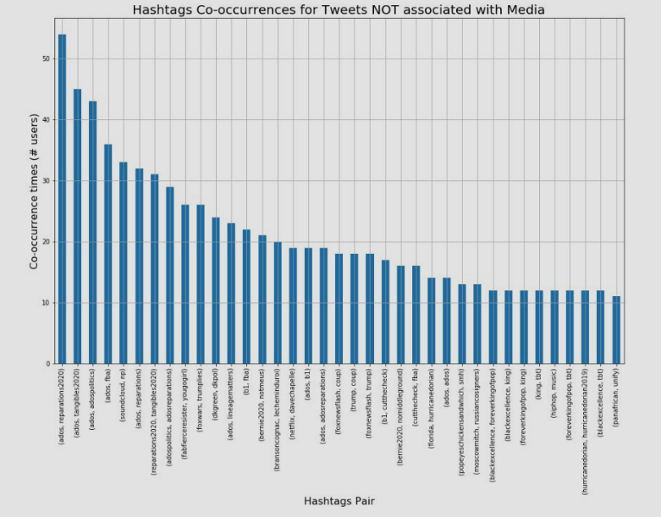
HashTag Co-occurrences without media

Slide 35
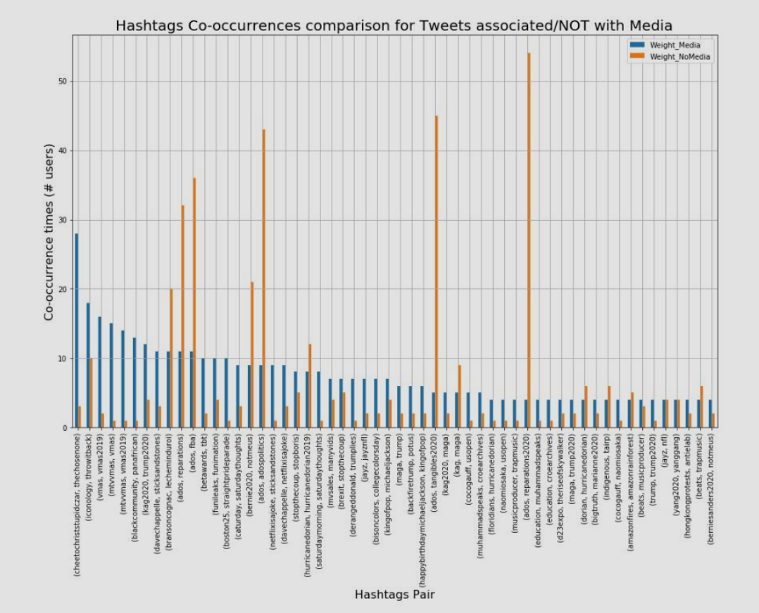
HashTag Co-occurrences (Intersection)

Slide 36
Method 5) Community Analysis
( User Mentions/Hashtag )

Slide 37
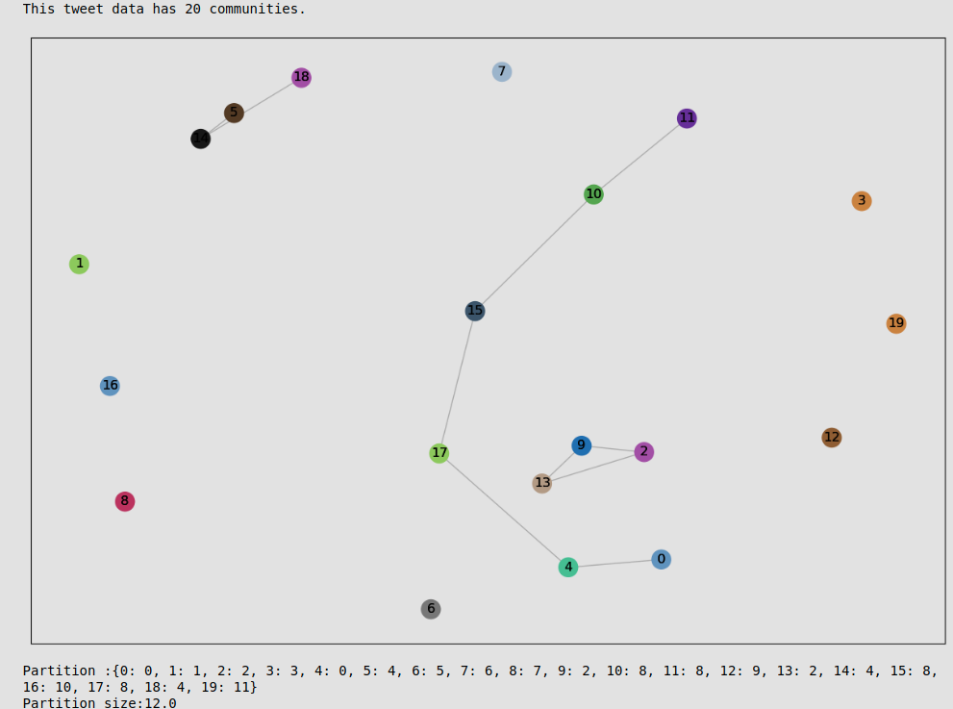
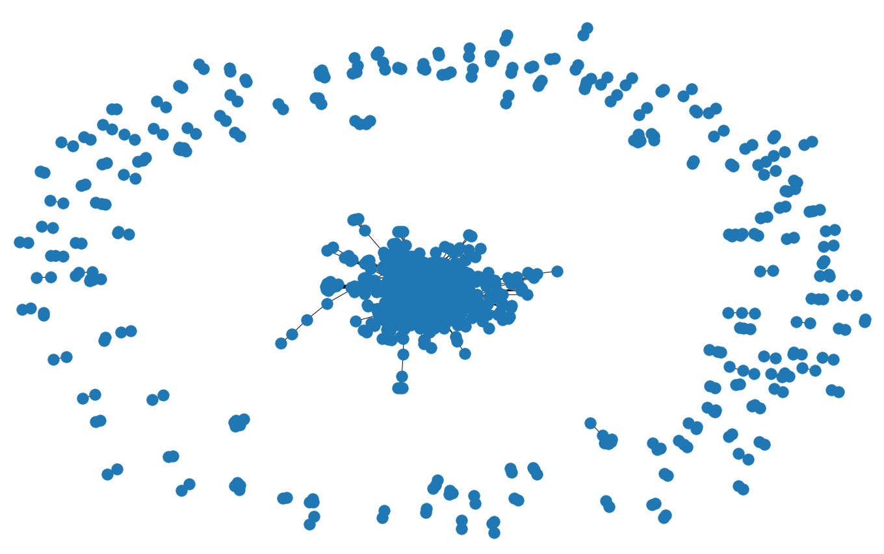
Topic Modeling of Tweets: (Community Detection)
20 communities are identified

Slide 38
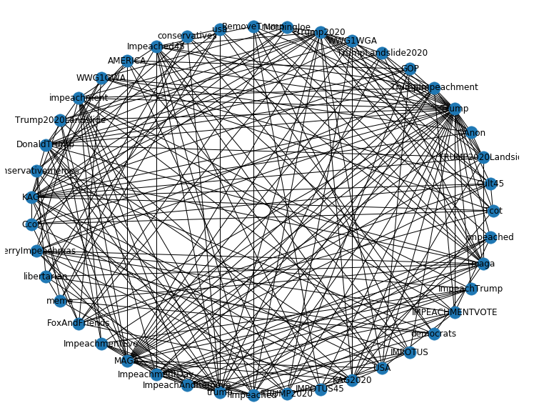
Topic Modeling of Tweets: (Community Detection)
K Value = 7 Hashtags: ['Ccot', 'Cult45', 'FoxAndFriends', 'KAG', 'KAG2020', 'MorningJoe', 'QAnon', 'TRUMP2020Landside', 'Tcot', 'Trump', 'Trump2020', 'Trump2020Landslide', 'WWG1GWA', 'WWG1WGA’] Topic 9 : ['impeachment', 'senate', 'democrats', 'gop', 'trial', 'republicans', 'dems', 'mcconnell', 'schiff', 'articles’] Hashtags: ['IMPEACHMENTVOTE', 'IMPOTUS', 'IMPOTUS45', 'ImpeachAndRemove', 'ImpeachTrump', 'Impeached', 'Impeached45', 'ImpeachmentDay', 'ImpeachmentEve', 'MerryImpeachmas', 'RemoveTrump', 'TrumpImpeachment', 'impeached', 'impeachment’] Topic 9 : ['impeachment', 'senate', 'democrats', 'gop', 'trial', 'republicans', 'dems', 'mcconnell', 'schiff', 'articles’] Hashtags: ['AMERICA', 'DonaldTrump', 'GOP', 'MAGA', 'TRUMP2020', 'TrumpLandslide2020', 'USA’] Topic 0 : ['trump', 'dont', 'another', 'say', 'amp', 'one', 'going', 'even', 'hes', 'believe’] Hashtags: ['conservativememes', 'conservatives', 'democrats', 'libertarian', 'maga', 'meme', 'trump', 'usa’] Topic 0 : ['trump', 'dont', 'another', 'say', 'amp', 'one', 'going', 'even', 'hes', 'believe']

Slide 39
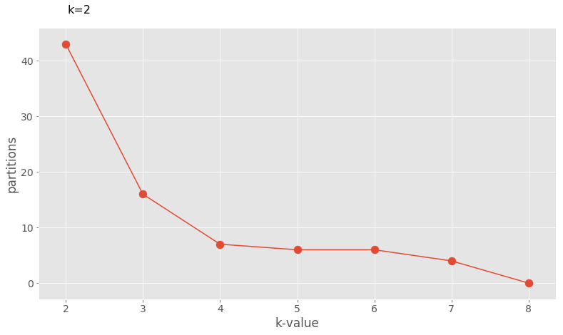
Topic Modeling of Tweets: (Community Detection)
Partition vs K value

Slide 40
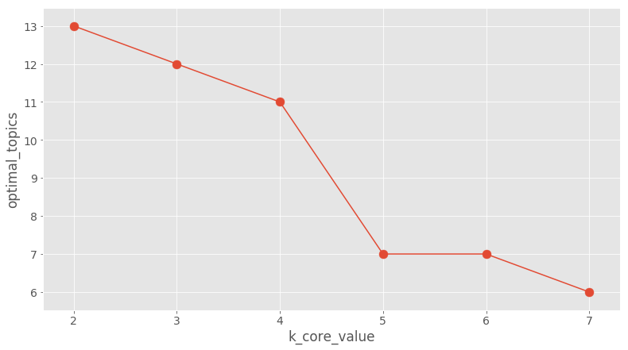
Topic Modeling of Tweets: (Community Detection)
Optimal Topic vs K value

Slide 41
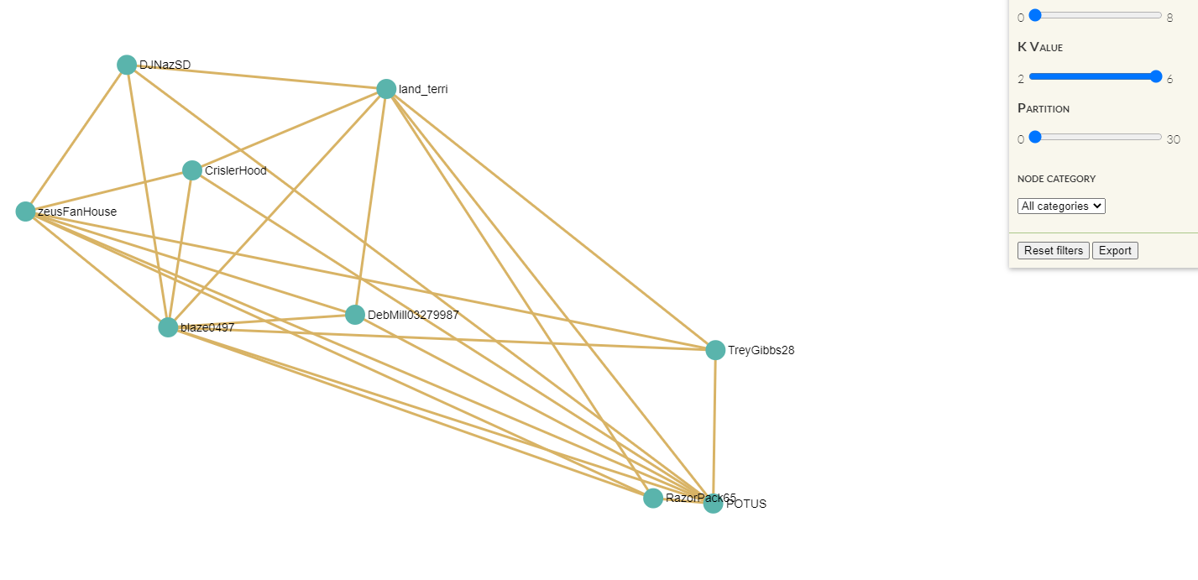
Interactive Graph Visualization

Slide 42
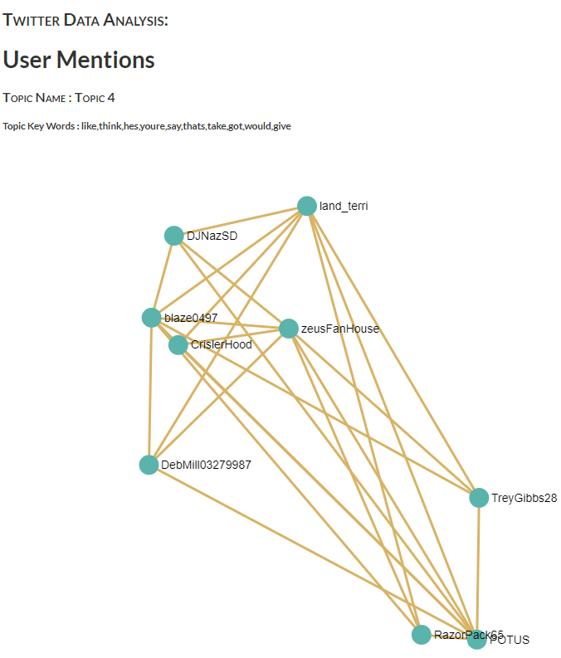
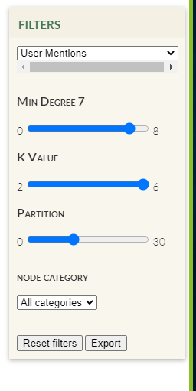
Interactive Graph Visualization

Slide 43
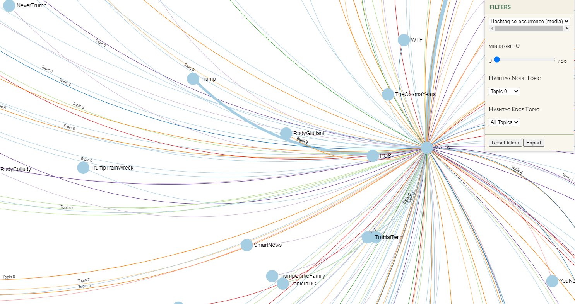
Interactive Graph Visualization

Slide 44
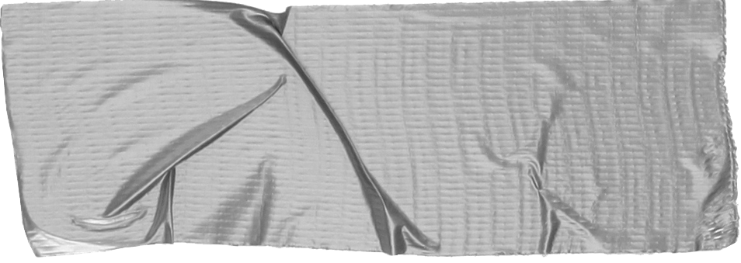
Demo
https://youtu.be/3vFiKJOSpLI

Slide 45
Conclusions
Text extraction from media files associated with tweets are, in most cases, supplementing the narrative of the tweet's text.
Media files are being used as a powerful tool to contaminate the original narrative of single/co-occurred hashtag pairs.
Object detection from images did not result in any additional insights.

Slide 46
Acknowledgments
Prof. Amarnath Gupta
Prof. Ilkay Altintas
All DSE professors and teaching assistants.
Staff at San Diego Supercomputer Center (SDSC)
And Twitter!

Slide 47
Twitter is powerful!
Questions?

