Slide 1
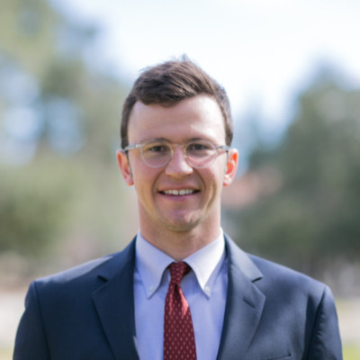
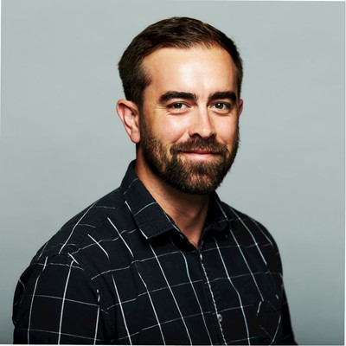
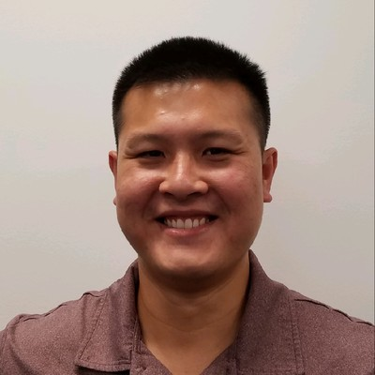
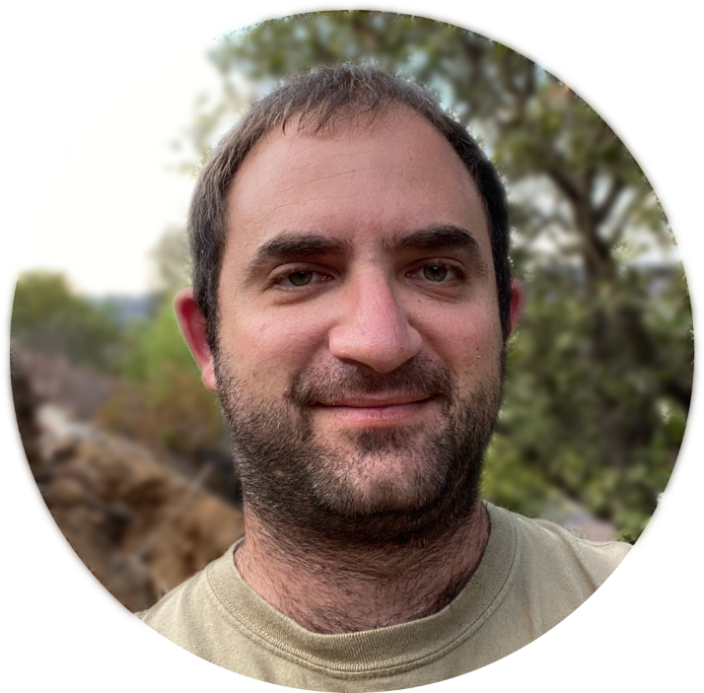
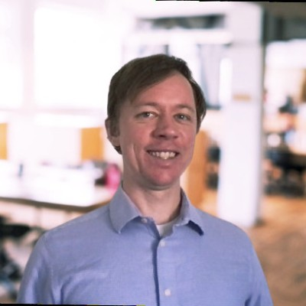
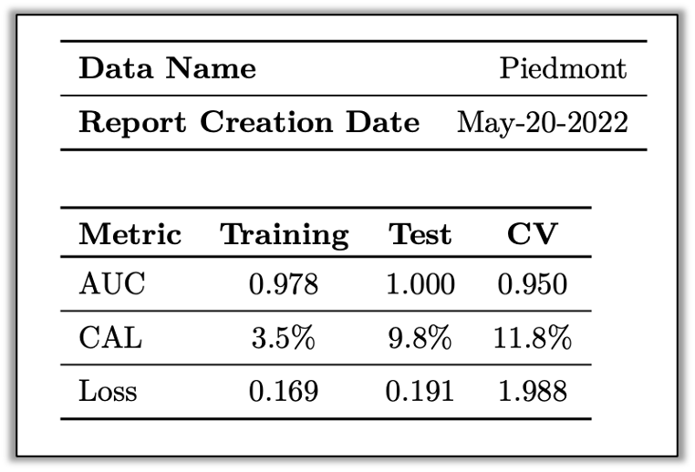
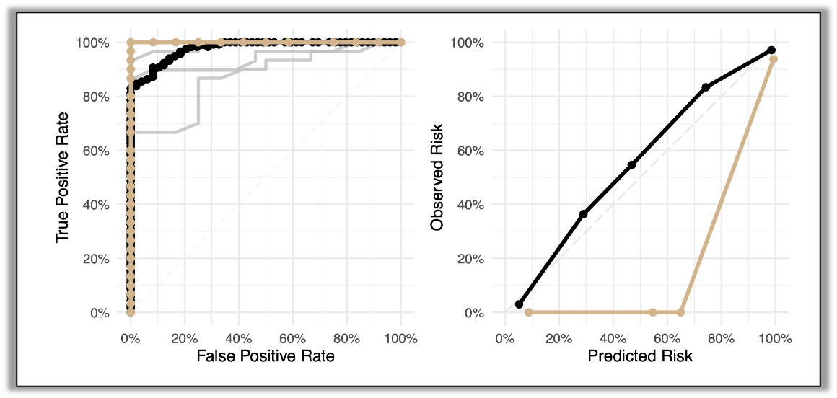
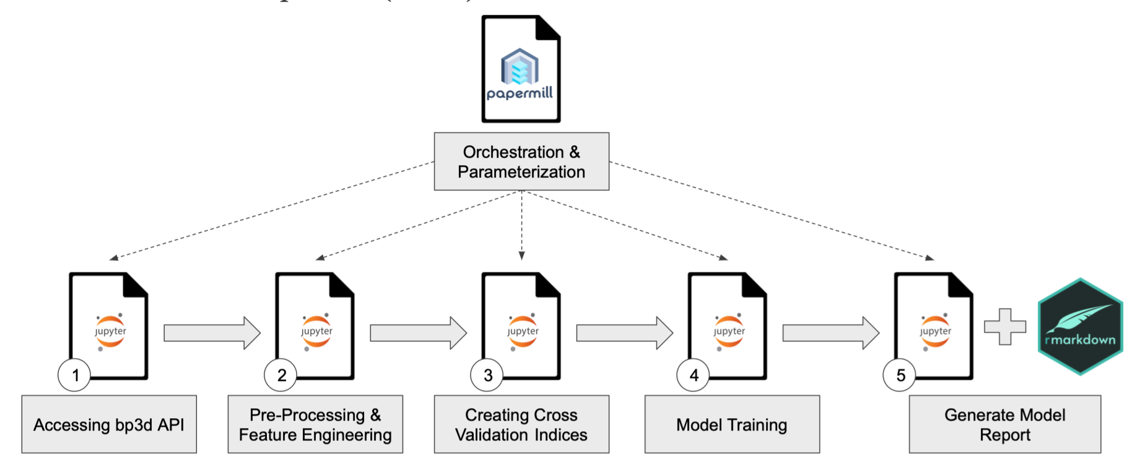
Prescribed Burn Optimization
Advisors:
Ilkay Altintas, Berk Ustun
Jonah Breslow
Sam Courtney
Lam Ho
Jeffrey Kagan
Steven Slovyan
Problem Statement
How do we quantify the risk profile of a candidate prescribed burn given an ensemble of simulated burns covering different combinations of meteorological factors?
Data Preparation
Features fire_behavior and ign_pattern are coded to 1 (unsafe/marginal) and 0 (safe).
A new feature is created by combining fire_behavior and ign_pattern by adding their values together.
Features joined with labels to produce one dataframe to be passed onto the next notebook.
Evaluation
Calibration Error (CAL) - Consistency of predicted risk v. “observed” risk
Area Under ROC Curve (AUC)
Architecture
Docker
Base image hosted on docker hub:
workunit1/python39-r
Local container add-ons:
bp3d python module
Directory structure
Papermill notebooks
Jupyter lab access on host machine
Host script extracts data from the container
Risk Calibration
Simulation runs are placed in equal-width risk bins. An observed risk and predicted risk value are calculated for each bin. These values are plotted against each other in a reliability diagram. A weighted average error is computed for each bin to compute calibration error metric.
Modeling
Unregularized Logistic Regression
Python, Scikit Learn package
5-fold cross validation
Cutoff-encoding of feature variables
One-hot-encoding of wind direction variable
Binary-encoded target variables
R and Reticulate package used for reporting
Key Insights
Risk of a prescribed burn can accurately be predicted using weather
Ignition pattern risk is more difficult to predict than fire behavior risk
Data Pipeline
Ensemble of simulation burns is generated by BurnPro3d.
User downloads the JSON and Excel files and places it in Data folder.
User runs single, Papermill-based, pipeline orchestrator notebook
Data Source
BurnPro3D API
JSON file containing meteorological data
Labels for simulation in Excel file
Final Product
Docker image
Zipped data
ReadMe on finding packages
Completed reports in PDF

