Slide 1
EarthCube
Sustaining the
Geosciences
for 21st Century
Challenges
Credits: from top to bottom: NOAA Okeanos Explorer Program (CC BY-SA 2.0), NASA/Kathryn Hansen (CC BY 2.0), and Canyonlands National Park/Neal Herbert (CC BY-NC-SA 2.0).
Notes:
An introduction to EarthCube and what it might mean to researchers

Slide 2
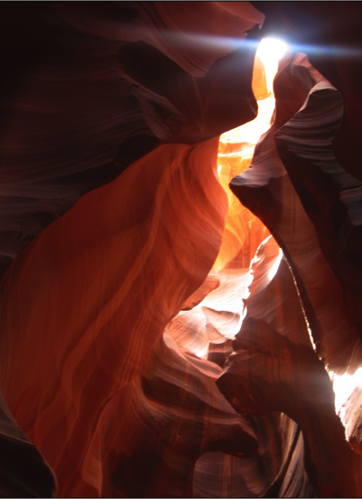
GOAL
Advance science
Meet grand challenges
Leverage shared cyberinfrastructure technology
M. Chan
Notes:
The future of the geosciences relies on understanding the complexities of a changing Earth system. This requires increasing levels of interdisciplinarity, and with it an increasing need for data sharing, re-use and interoperability.
But there are institutional and social barriers to data sharing.

Slide 3
GOAL
Advance science
Meet grand challenges
Leverage shared cyberinfrastructure technology
“Data use challenges are half technical and half social.”
–Someone at almost every professional science meeting
M. Chan
Notes:
The future of the geosciences relies on understanding the complexities of a changing Earth system. This requires increasing levels of interdisciplinarity, and with it an increasing need for data sharing, re-use and interoperability.
But there are institutional and social barriers to data sharing.

Slide 4
GOAL
Advance science
Meet grand challenges
Leverage shared cyberinfrastructure technology
Balancing infrastructure development & scientific advancement to create sustainable, multidisciplinary solutions
M. Chan
Notes:
To overcome both social & structural barriers the NSF Directorate of Geosciences & Cyberinfrastructure initiated EarthCube, to develop community led solutions to the considerable challenges of 21st Century geosciences.

Slide 5
GOAL
Advance science
Meet grand challenges
Leverage shared cyberinfrastructure technology
Science
End User
Workshops
EC
Committees
RCNs
Interactive
Activities
Building
Blocks
Cyber
Infrastructure
Balancing infrastructure development & scientific advancement to create sustainable, multidisciplinary solutions
M. Chan
Notes:
Balancing “Scientific Progress” and “Cyberinfrastructure Development” is, on the face of it, a significant challenge, but it requires acknowledging that many of the cyberinfrastructure solutions are scientifically driven. Regardless, the portfolio of initiatives that EarthCube has supported reflect both fundamental investments in cyberinfrastructure development, but also outreach and scientific advancement within the geosciences.

Slide 6
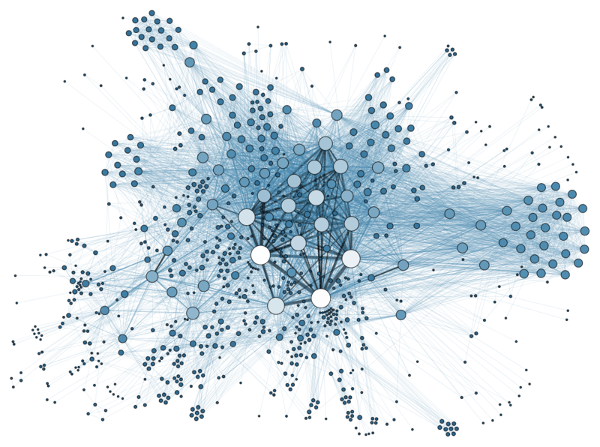
Institutional
Repositories
Data
Centers
Community-Led
Databases
Governmental
Organizations
Field
Geoscientists
Industry
Partners
But the Landscape is Fragmented
"Social Network Analysis Visualization" by Martin Grandjean https://commons.wikimedia.org/wiki/File:Social_Network_Analysis_Visualization.png#/media/File:Social_Network_Analysis_Visualization.png
Notes:
The fundamental challenge is to bring all the players to the table, but we face a fractured & fragmented landscape.

Slide 7
Facilitating Data Sharing & Reuse
Interdisciplinary Communication
Data-Model Integration
Software & Data Management
"Social Network Analysis Visualization" by Martin Grandjean https://commons.wikimedia.org/wiki/File:Social_Network_Analysis_Visualization.png#/media/File:Social_Network_Analysis_Visualization.png
Notes:
Through EarthCube we hope to bring all geoscientists into the fold, providing solutions to data sharing, attribution, integration & discovery, so that we can build solutions together.
Repeat here - EarthCube’s Goals:
Advance science
Meet grand challenges
Leverage shared cyberinfrastructure technology
(The following slides give some examples of RCNs and BBs. The speaker should choose 1-3 that apply to their work, and edit the slides accordingly).

Slide 8
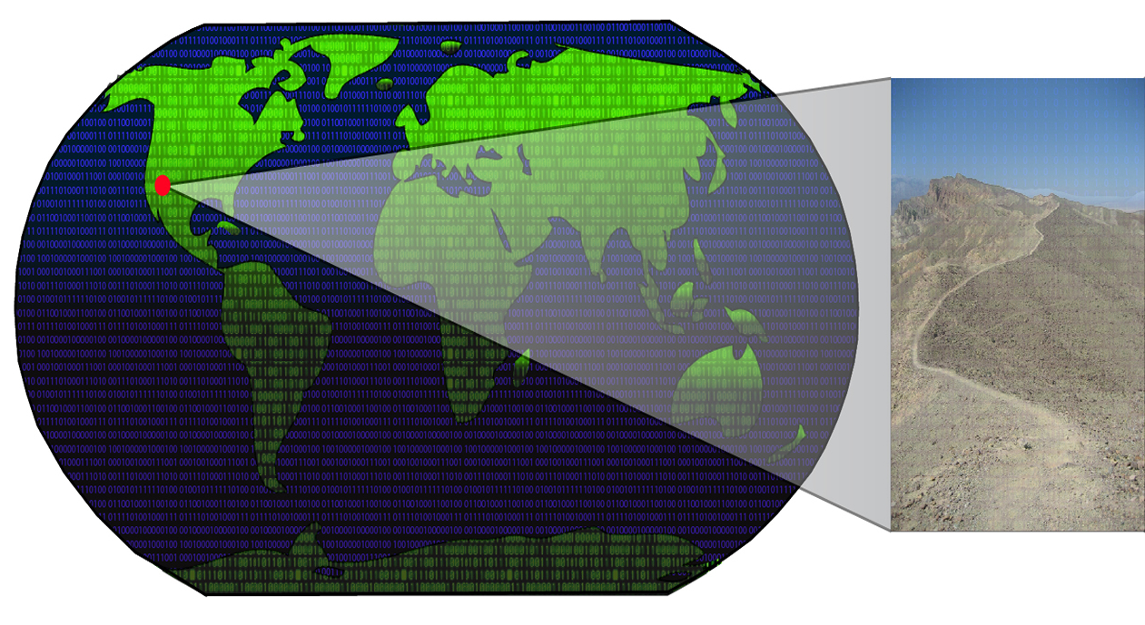
Research Coordination Networks RCNs
Cyber4Paleo
Collaboration & Cyberinfrastructure for Paleogeosciences
C4P RCN focuses on development of standards for aggregation & dissemination of paleogeoscience data, to facilitate research on Earth-Life history.
https://www.youtube.com/user/cyber4paleo
EC3
Earth-Centered Communication for Cyberinfrastructure: Challenges of Field Data Collection, Management & Integration
EC3 network aims to facilitate dialogue between field-based geologists, and computer and social scientists to address problems faced by field-based geological community.
-
SEN
Sediment Experimentalist Network
SEN aims to improve efficiency and transparency of sedimentary research for field geologists, modelers, & experimentalists.
Notes:
To that end, research coordination networks have been developed to connect domain scientists to developments in cyberinfrastructure, providing a range of resources.
The suggestion is to pick & choose three RCNs that the speaker feels would be best suited to the audience from the next two slides.

Slide 9
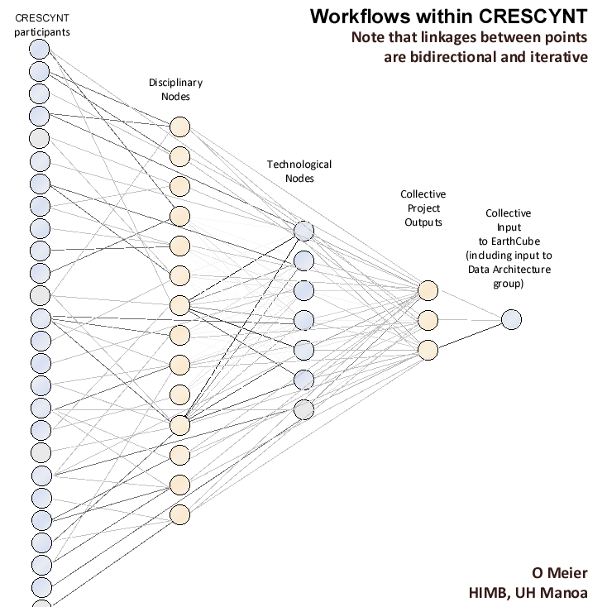
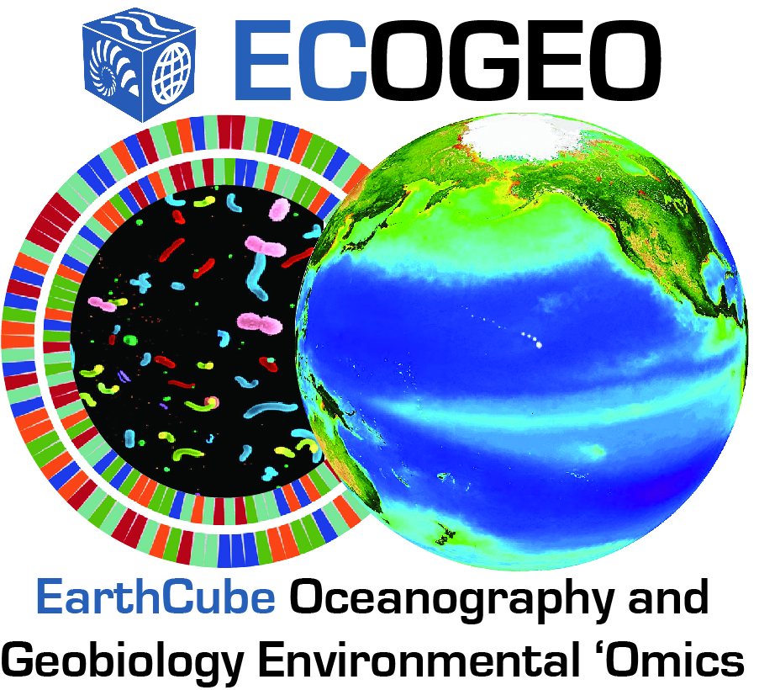
Research Coordination Networks RCNs
CRESCYNT
Coral Reef Science & Cyberinfrastructure Network
CRESCYNT is working to improve data discoverability, interoperability and integration for multiple data types, scales and disciplines of coral reef science and connected fields.
iSamples
Internet of Samples in Earth Sciences
iSamples RCN is to dramatically improve discovery, access, sharing, analysis, and curation of physical samples and data generated by their study.
-
ECOGEO
EarthCube Oceanography & Geobiology Environmental ‘Omics
ECOGEO will facilitate integration ocean/geoscience and cyberinfrastructure ‘omics domains and environmental data, to better adapt to rapidly changing technologies for data acquisition and analysis.

Slide 10
Building Blocks (BB)
BCube
A Broker Framework for Next Generation Geosciences
Building tools to improve data brokering & improving access valuable data by developing web crawlers.
Earth System Bridge
Spanning Scientific Communities with Interoperable Modeling Frameworks
Earth System Bridge will allow interoperable modeling frameworks, enabling communities to collaborate and advance earth system science.
-
GeoDeepDive
A Cognitive Computer Infrastructure for Geoscience
Developing capabilities in machine reading to benefit scientists in all domains & creating infrastructure to lower barriers to text and data mining activities.
Notes:
Again, can replace projects here. We suggest picking three that might have particular resonance for the speaker or the location.
GeoSoft Collaborative Open Source Software Sharing for the Geosciences
GeoWS Geoscience Web Services
ODSIP An Open Data-Services-Invocation Protocol (ODSIP)
CHORDS Cloud-Hosted Real-Time Data Services for the Geosciences
CyberConnector - Bridging the Earth Observations and Earth Science Modeling for Supporting Model Validation, Verification, and Inter-comparison
Digital Crust - An Exploratory Environment for Earth Science Research and Learning
EarthCollab - Enabling Scientific Collaboration and Discovery through Semantic Connections
GeoDataspace - Simplifying Data Management for Geoscience Models
GeoLink - Leveraging Semantics and Linked Data for Data Sharing and Discovery in the Geosciences
GeoSemantics - A Geo-Semantic Framework for Integrating Long-Tail Data and Models

Slide 11
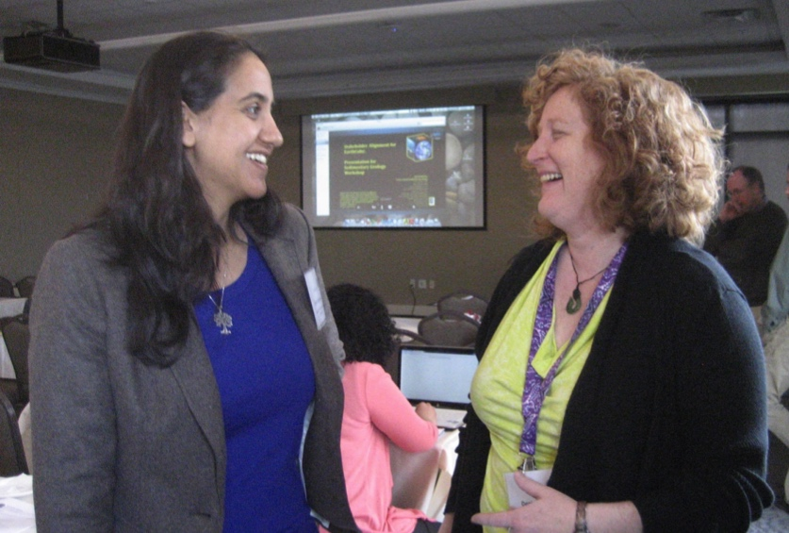
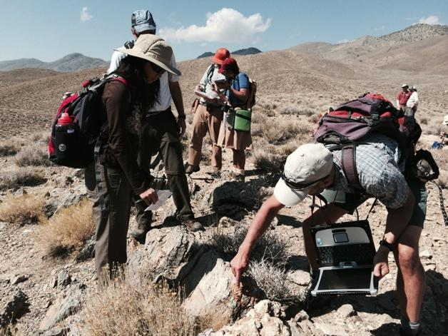
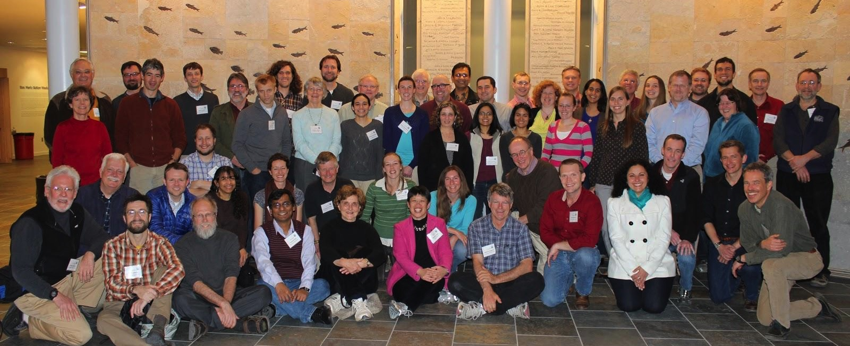
M. Chan
M. Chan
Y. Gil
Photo: S. Paxton
Notes:
Ultimately EarthCube is about people, so how can you participate?

Slide 12
Get Involved!
Leadership Council
Office
Science Committee
Engagement Team
Technology & Architecture Committee
Council of Data Facilities
Liaison Team
Talk to EarthCube Participants!
Attend EarthCube Workshops!
Join the mailing list at earthcube.org
Follow on twitter @earthcube
Apply for funding (EC Travel Grants, Distinguished Lecturers)
Notes:
Alternate layout of previous slide…

